Slide 1
Databases for research with an example of using Python and IMDb
By Robert Williamson PhD student:
Research areas: British Government film policy during World War II

Slide 2
INTRODUCTION
Google open access databases
IMDb film database
Python and IMDb using IMDbpy
Conclusions

Slide 3
INTRODUCTION
“To do film history today, one has to become an economic historian, a legal expert, a sociologist, know about censorship, read trade papers and fan magazines” Elsaesser, Thomas ‘The New Film History’ Monthly Film Bulletin, Autumn 1986

Slide 4
Google Datasets
Google had just released datasetsearch, a free tool for searching 25 million publicly available datasets.
The results include descriptions of the datasets contents as well as author citations.
Google relies on the dataset publishers to use the open standards of schema.org to describe their dataset’s metadata. Google then indexes and makes that metadata searchable across publishers.
Early days…view and feedback on the Blog:- https://blog.google/products/search/discovering-millions-datasets-web/

Slide 5
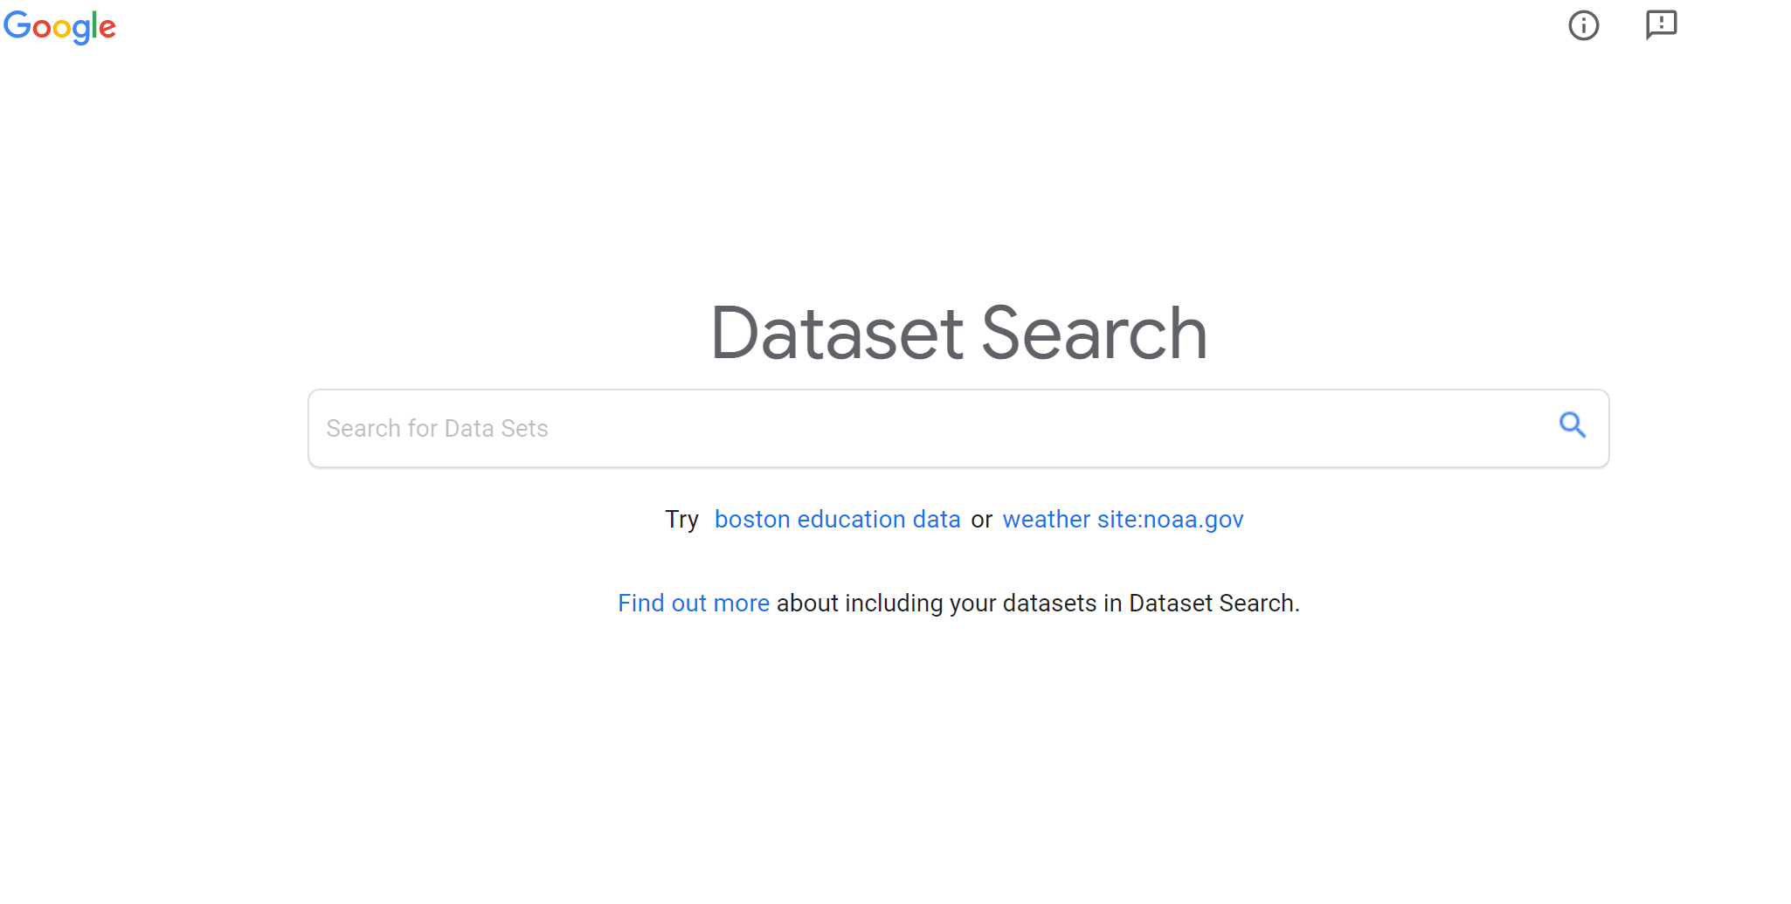

Slide 6
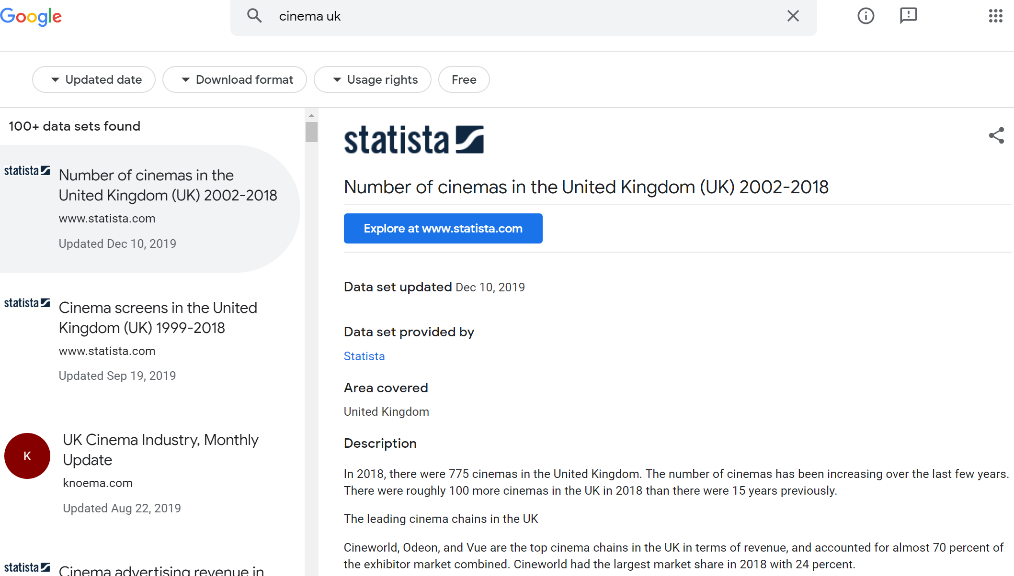

Slide 7
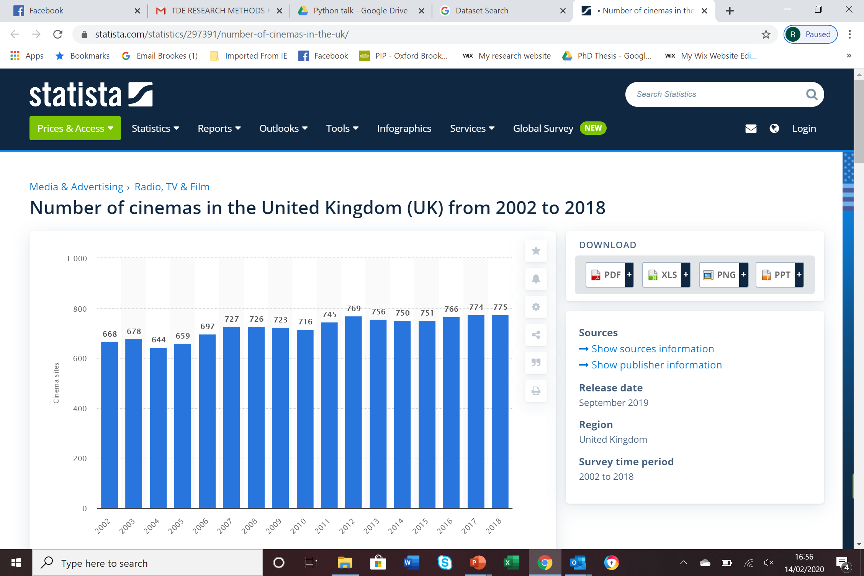

Slide 8
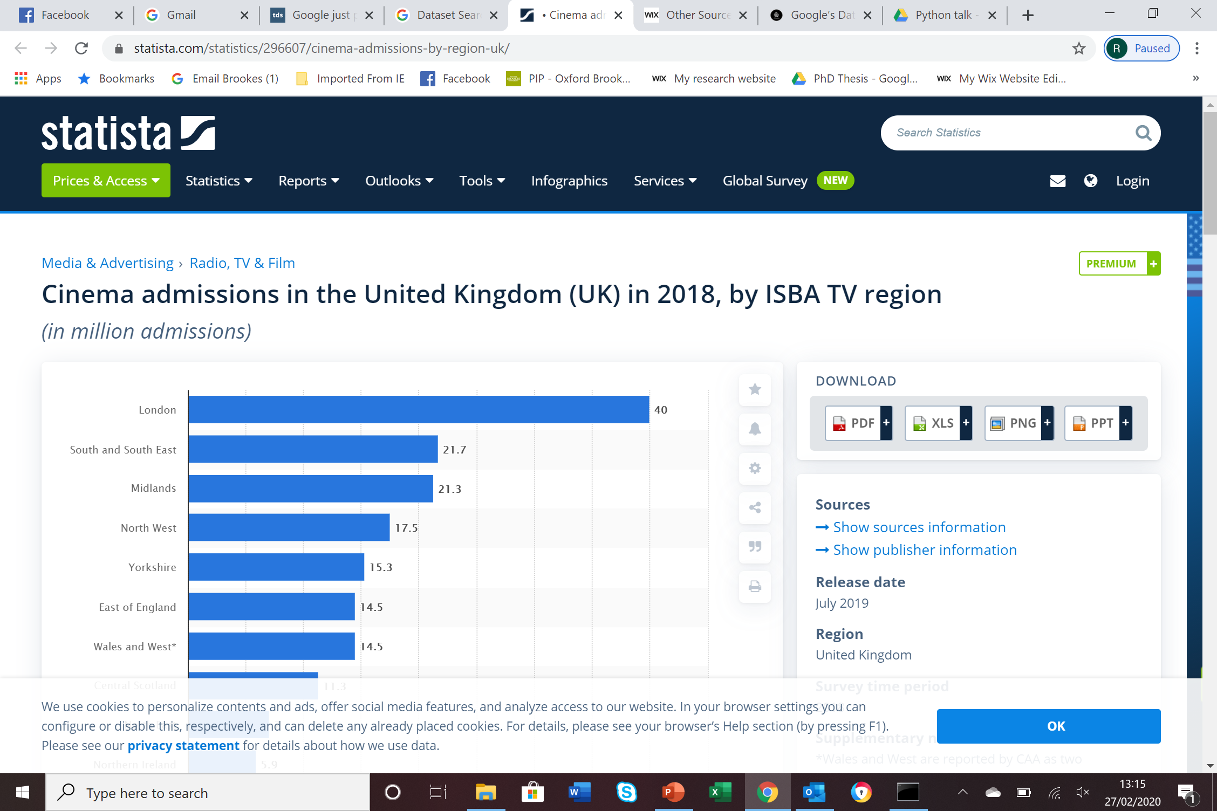

Slide 9
IMDBpy Basics
https://pypi.org/project/IMDbPY/
IMDb has over six millions titles
IMDbpy Provides access methods to dataset via Python
Get movie information with search options (keywords, actor, title or partial title).
Get movie information (all that IMDb holds)
Get actor information (all)
Get top 250 movies

Slide 10
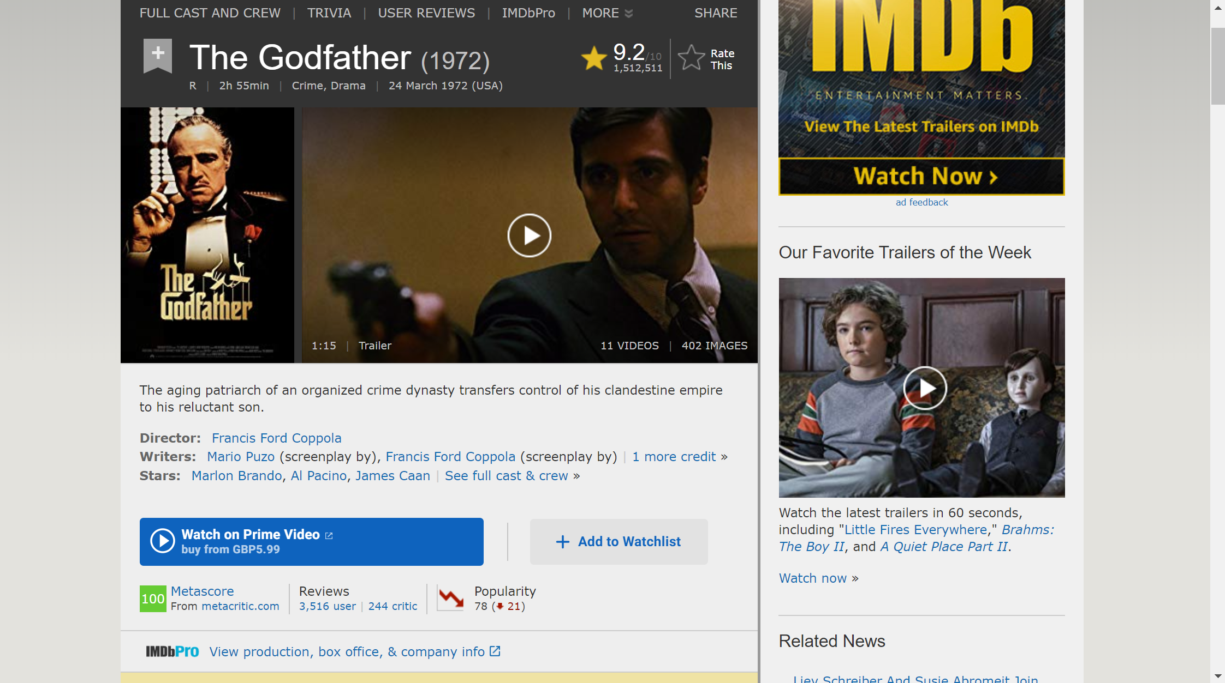

Slide 11
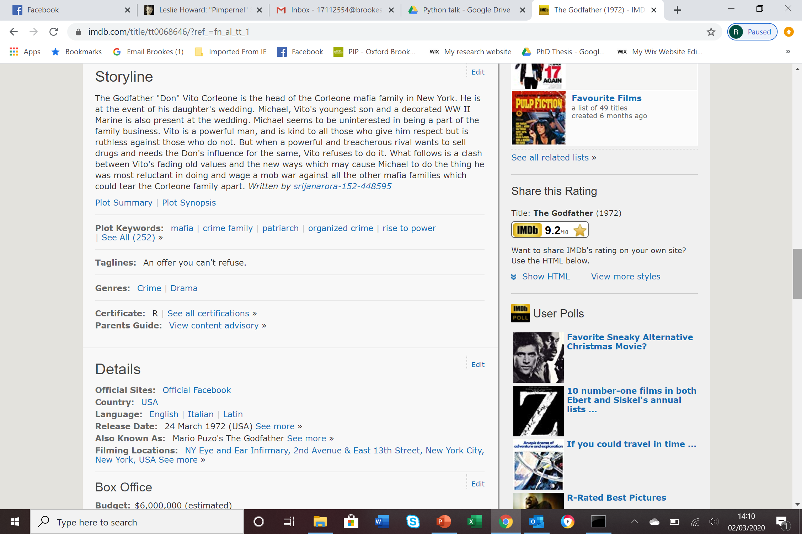

Slide 12
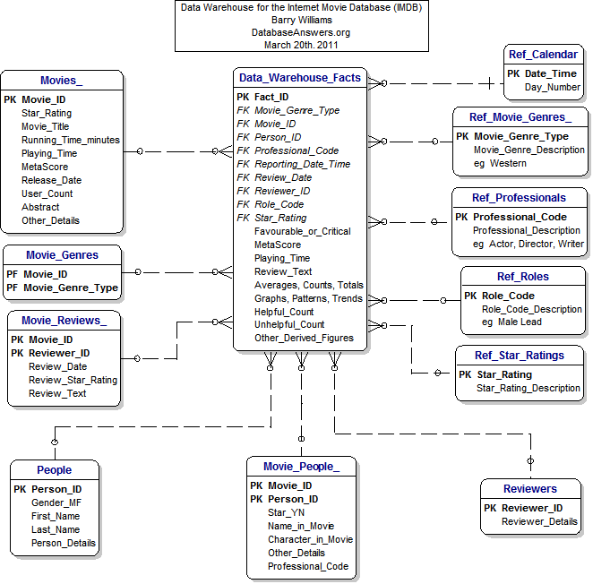
IMDb database contents and their relationships

Slide 13
Python programming language
Presence of Third Party Modules: ...
Extensive Support Libraries: ...
Open Source and Community Development: ...
Learning Ease and Support Available: ...
User-friendly Data Structures: ...
Productivity and Speed:

Slide 15
import imdb
ia = imdb.IMDb()
top250 = ia.get_top250_movies()
# Iterate through the first 20 movies in the top 250
for movie_count in range(0, 20):
# First, retrieve the movie object using its ID
movie = ia.get_movie(top250[movie_count].movieID)
# Print movie title and genres
print(movie['title'])
print(*movie['genres'], sep=", ")

Slide 16
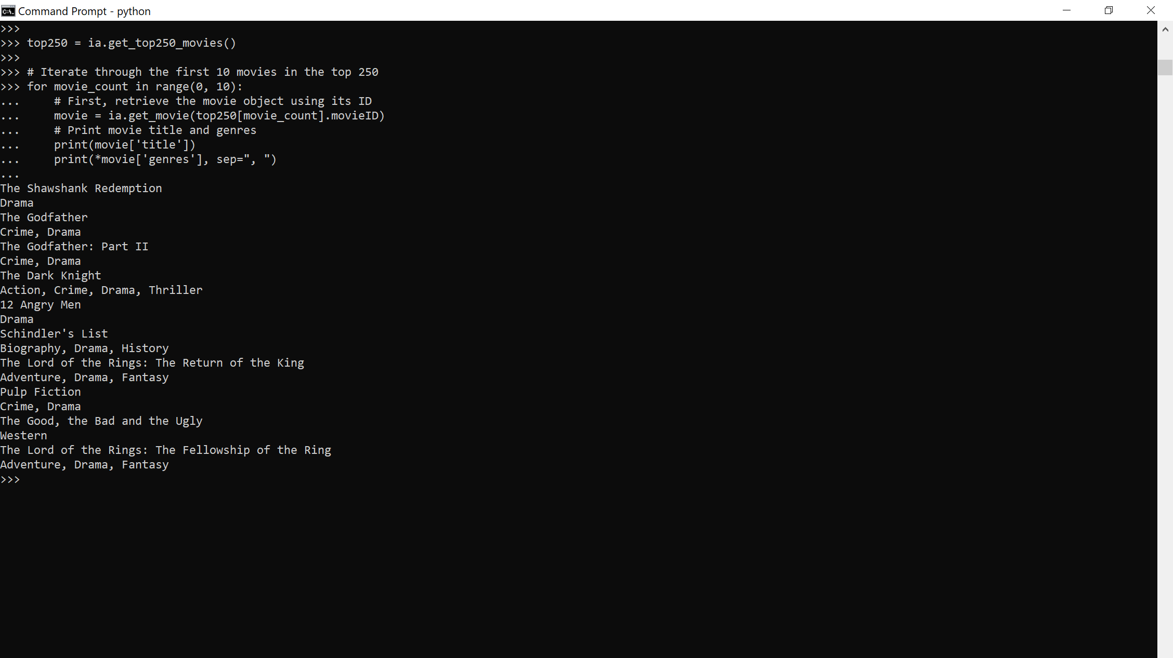

Slide 17
CONCLUSIONS
Ongoing: Datasets being made public and being put on line:- https://datasetsearch.research.google.com/
Searching Datasets is improving
With code (eg Python), sophisticated searches can be performed.
Free 5 hour course online for Python :- https://www.udemy.com/course/python-programming-beginners/

