Slide 1
The Ministry of Information and the British Film Hero during World War 2
B by Robert Williamson

Slide 2
Main Research
Analysis of the processes and relationships by which the Government (for example Ministry of Information (MoI) and the Films Division) operated with the Film Studios in feature film content and production. Examine the hypothesis that these processes worked in practice but test if the relationships were collaborative or conflicted.
Within the above framework, inspect the correlation between government and film studios policies and the changing role of the hero in wartime films.
British Government
Ministry of Information
Film Division
Film Studios
Primary Sources
Secondary Sources

Slide 3
BRITISH GOVERNMENT
Churchill
War Cabinet
Treasury
War Office
Admiralty
RAF
Other Ministries, including SIS
Film Censors
Political Warfare Executive
BBC
Ministry of Information
Films
Division

Slide 4
Newspapers
OUTSIDE GOVERNMENT
Oxbridge Dons advice
Gentleman Clubs
BFI
Documentary News Letter
Trade Journals
Other Outside bodies/committees
Film Studios
Ministry of Information
Films
Division

Slide 6
“To do film history today, one has to become an economic historian, a legal expert, a sociologist, know about censorship, read trade papers and fan magazines” Elsaesser, Thomas ‘The New Film History’ Monthly Film Bulletin, Autumn 1986
B

Slide 7
Ministry Of Information Hierarchy 1941 (Addition of Ideas Committee)
Ministry Of Information
Planning Committee
Policy Committee
Documentary News Letter
Ideas Committee
Film Division
Crown Film Unit
Film Studios
Ealing
Rank
Gainsborough
Information and control:
Critical Comment::
Notes:
Feuer – ‘‘The musical as a genre perceives the gap between producer and consumer, the breakdown of community designated by the very distinction between "performer" and "audience" as a breach which it must heal. The musical seeks to bridge the gap through a valorization of "community" as an ideal concept. ‘
That is – the musical masks the manner of its production as elaborate industrial product in order to present events as if they were effortlessly spontaneous and representative of ordinary lives
Feuer, J. (1981). The Self-Reflective Musical and the Myth of Entertainment. In R. Altman, Genre: The Musical (pp. 159-174). London: Routledge and Keegan Paul.

Slide 8
Sources
Unpublished Primary (such as National Archives, Papers, Ministry Offices)
Published (such as Newspapers and magazines, journals)
Mass Observation Unit
Books and Articles
Memoirs
BFI: Special Collections
PhDs
Be a detective...follow the paper trail

Slide 9
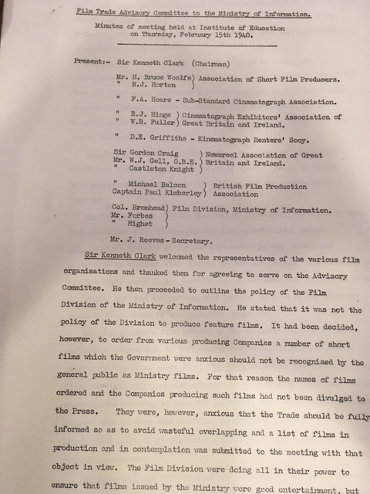

Slide 10
Exercises
robertwilliamson61.wixsite.com/websiteforphd
National Archives: Search MOI for Films Division, Ideas Committee etc. Note no downloads
Mass Observation Online (search for Lion has Wings in advanced, use AND)
Home Intelligence Reports
War Time Social Surveys (search for cinema, results online. No login required)
Newspaper Library: Search for ‘+ministry +of +information+cinema’ or Target for tonight’. Note no need to logon
Documentary News Letter on line : Year 1940. Search for Films Division
For reviews : Sight and Sound on line at Brookes (or newspapers)

Slide 11
Exercises
On line film publications: Search for Kinematograph Weekly. Choose 1944 version and search for Millions like Us
On line film publications: Search for Motion Picture Herald.
A new idea: Use Python to access archives:- https://programminghistorian.org/en/lessons/
For example IMDbpy (set of modules to access film data)
https://imdbpy.github.io/

