Slide 1
British National Cinema
1939-1945

Slide 2
Presentation
Introduction
Background to the research
Origins: from ‘Realist’ school in 1930’s
The Ministry of Information
Role of Government/Funding
Issues from research
Propaganda and National Identity
Comedy and Auteurs
Conclusions
Showing of Two Short Films (Listen to Britain/London Can take it)
Notes:
Some issues about popularity – ‘Is it the films that made the most money or the films that the largest number of people saw?’ Dyer Richard and Ginette Vincendeau eds. (1991) 'Popular European Cinema' London, Routledge page 3

Slide 3
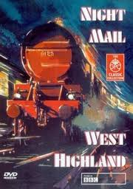
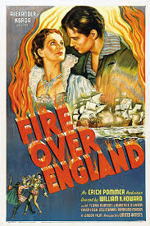
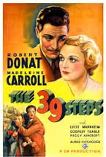
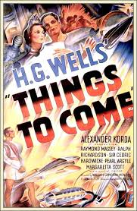
1930s Cinema in Britain
Richards, J (1998) The Unknown 1930s (London: Tauris)
Thompson, D (2013) The Big Screen (London:Penguin)

Slide 5
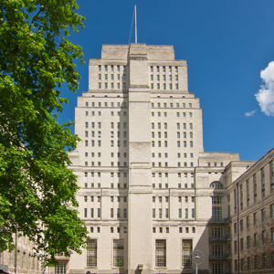
Senate House (Ministry of Information)

Slide 6
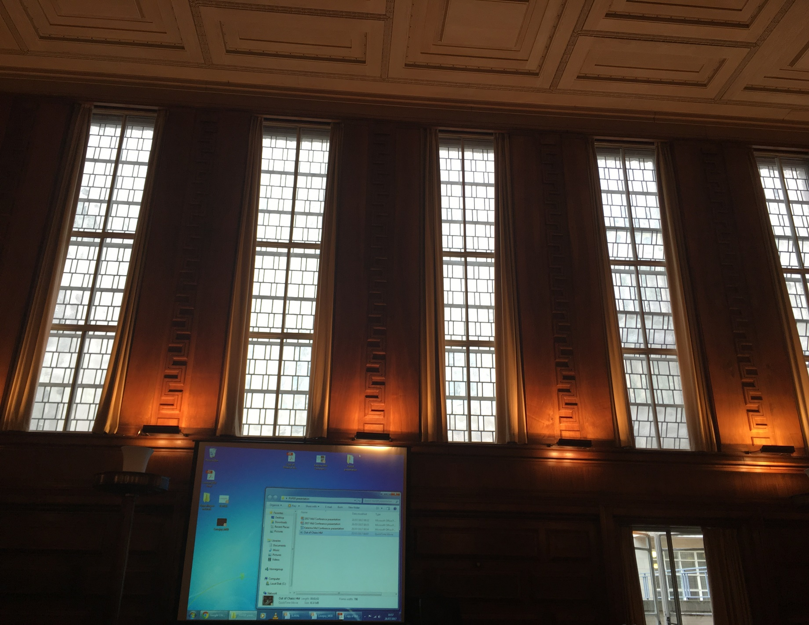

Slide 7


Slide 8
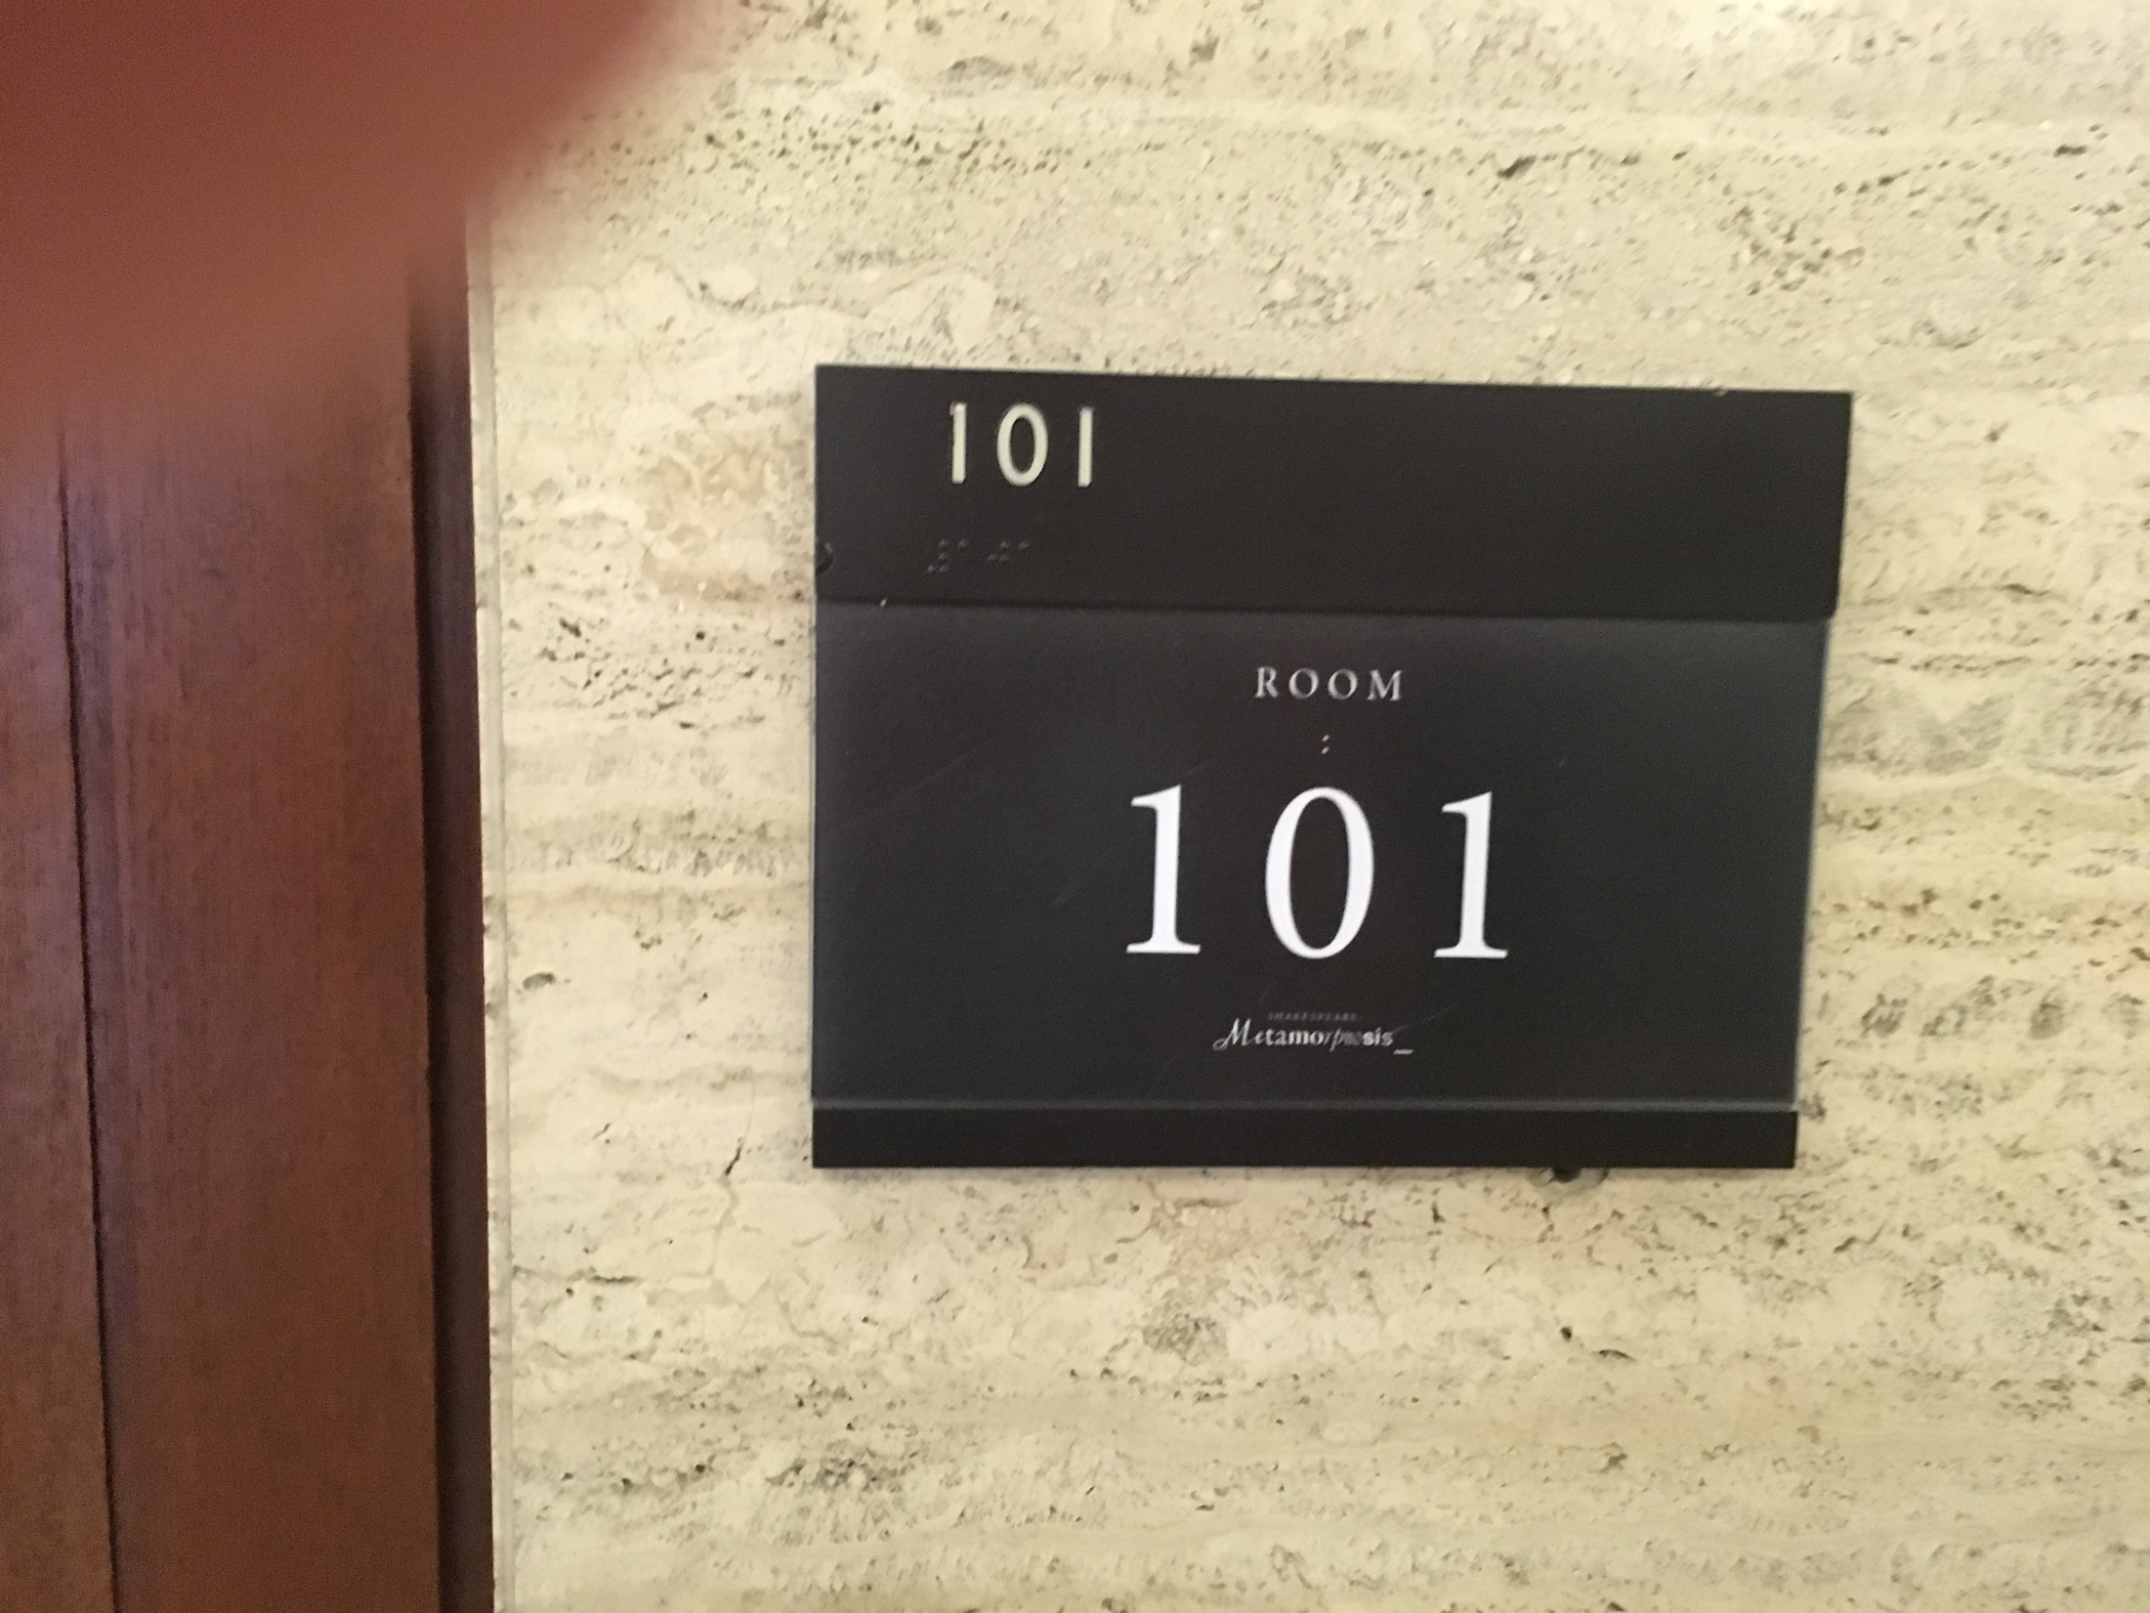

Slide 9
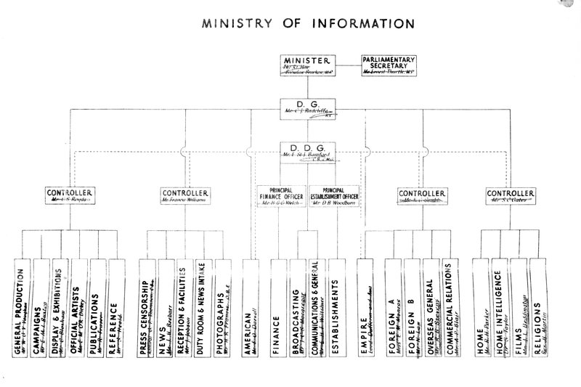

Slide 10
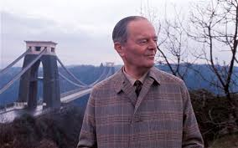

Slide 11
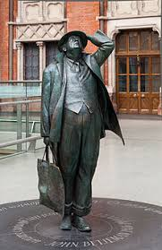

Slide 12
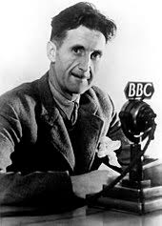

Slide 13
Ministry Of Information Hierarchy
Ministry Of Information
Planning Committee
Intelligence Division
Policy Committee
Documentary News Letter
Film Division
Film Studios
Information and control:
Critical Comment:
Notes:
Feuer – ‘‘The musical as a genre perceives the gap between producer and consumer, the breakdown of community designated by the very distinction between "performer" and "audience" as a breach which it must heal. The musical seeks to bridge the gap through a valorization of "community" as an ideal concept. ‘
That is – the musical masks the manner of its production as elaborate industrial product in order to present events as if they were effortlessly spontaneous and representative of ordinary lives
Feuer, J. (1981). The Self-Reflective Musical and the Myth of Entertainment. In R. Altman, Genre: The Musical (pp. 159-174). London: Routledge and Keegan Paul.

Slide 14
Role of Government/Funding
Ministry of Information (planning since 1935)
Four layers of committee for film
GPO and Crown Film Unit
Korda sent to Hollywood by Churchill
Balcon puts Ealing Studio on War footing
Ealing, British National and Elstree requested by MOI to make patriotic films
Rank Organisation funded half of British films 1941 to 1947

Slide 15
Issues from Research
Some films were popular with public but disliked by rulers
Film Critics still critiqued… ‘The most disgraceful production that has ever emanated from a British Film Studio’ – Life and Death of Colonel Blimp
Pressure to show realism and documentary
BBFC (British Board of Film Censorship) had rules: Were these followed?
Promotion of National Identity
Arguments over definition of Propaganda
Influence of foreign film makes (e.g. Cavalcanti)
Depiction of British Class System
Notes:
Feuer – ‘‘The musical as a genre perceives the gap between producer and consumer, the breakdown of community designated by the very distinction between "performer" and "audience" as a breach which it must heal. The musical seeks to bridge the gap through a valorization of "community" as an ideal concept. ‘
That is – the musical masks the manner of its production as elaborate industrial product in order to present events as if they were effortlessly spontaneous and representative of ordinary lives
Feuer, J. (1981). The Self-Reflective Musical and the Myth of Entertainment. In R. Altman, Genre: The Musical (pp. 159-174). London: Routledge and Keegan Paul.

Slide 16
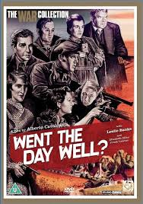
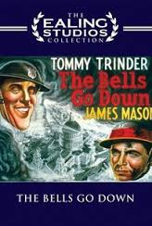
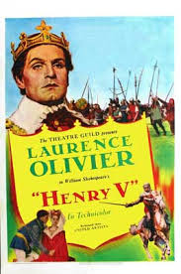
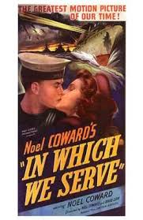
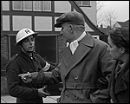
Propaganda and National Identity
Ordinary People 1941

Slide 17

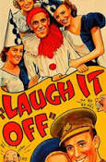
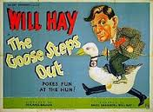
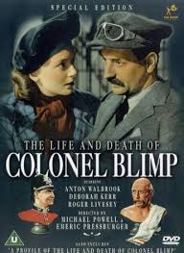
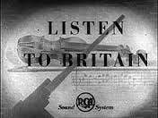
Comedy and Auteurs

Slide 18
Conclusions
Enormous diversity of films
Wide variation on how films received (Britain and USA)
Were films popular? (19 million visits 1939 to 30 million 1945)
Average of 70 films made each year. Who decided?
Three quarters of films came from Hollywood
Pulling together of talents (some from Armed forces)
Large amount of background material, but unfortunately some paper records junked or destroyed
More and more archives being put on line

Slide 19
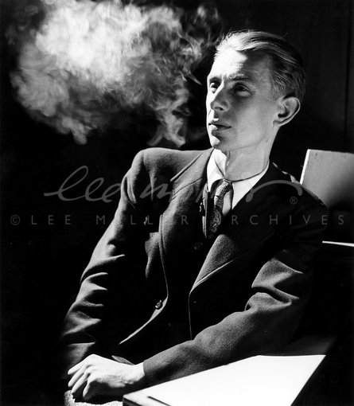
Humphrey Jennings: filmmaker, photographer, literary critic, theatrical designer, poet, painter and theorist of modern art

