Slide 1
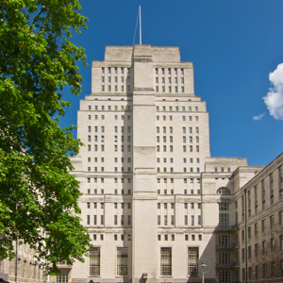
Government feature film policy in World War 2 by Robert Williamson

Slide 2
Presentation
Introduction
My PhD journey to date
Overview of my research
Conclusions (so far)
Notes:
Some issues about popularity – ‘Is it the films that made the most money or the films that the largest number of people saw?’ Dyer Richard and Ginette Vincendeau eds. (1991) 'Popular European Cinema' London, Routledge page 3

Slide 3
Key research questions
Whether or not the production of home-grown feature films was really a product of a relationship between the MOI and the Film Studios. How did it operate?
How did Government desires of propaganda actually work on a day-to-day basis for filmmakers during WW2? And did the changing role of the hero in wartime films correlate with government and film studios evolving policies on propaganda?

Slide 4
Theory
Chomsky
Levi-Strauss
Arthusser

Slide 5
Structure
Decisions on secondary sources
Decisions of primary sources
Chapters
Case Studies
Conclusions and further research

Slide 6
Examples of Sources
Unpublished Primary (such as National Archives, Papers, Ministry Offices)
Newspapers, magazines, journals.
Books and Articles
Memoirs
BFI: Special Collections

Slide 7
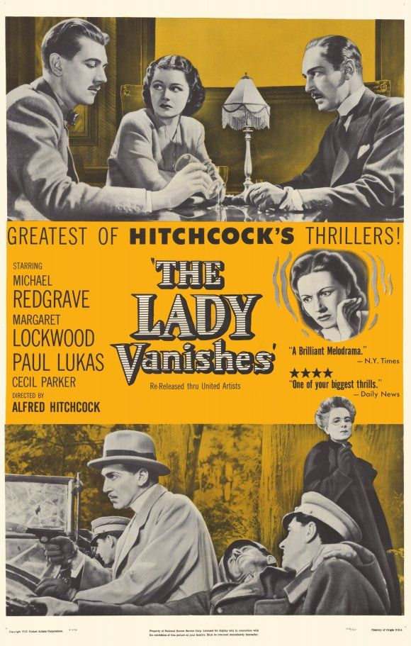
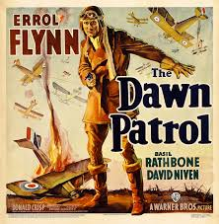
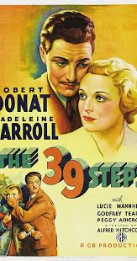
Pre WW2: Hero as British Gentleman
1938
1938
1935

Slide 8
Ministry Of Information Hierarchy
Ministry Of Information
Planning Committee
Policy Committee
Ideas Committee
Film Division
Crown Film Unit
Film Studios
Ealing
Rank
Gainsborough
Information and control::

Slide 9
Conclusions (so far)
In both the MOI and elsewhere in government, there was a lack of ownership and responsibility involving film making. Although this improved in later years, it remained a hindrance.
Arguments over the definition of Propaganda and how to use it continued throughout the War.
Within the MOI and the film studios, well-connected via privilege individuals did make the difference in terms of decision making. In some instances, their membership of the same gentlemen’s club provided direct or indirect connections with the War Cabinet.
Heroic representations in feature films were characterised by changing presentations of morality as the war progressed. Distinction between what was right or wrong in film was a continued area of conflict within the MOI.
Eventually Women were presented on screen as leading heroic characters, mainly due to enormous societal change resulting from the requirements of the war.
Heroes, in some shape or form, were a pervasive vehicle of British cinema to deliver propaganda during the 1940s. Furthermore, this was the first time in British cinema that government leadership had promoted their exploitation for propaganda messages, whether overt or covert.
My Website: robertwilliamson61.wixsite.com/websiteforphd

Slide 10
