Slide 1

The Ministry of Information and the British Film Hero during World War 2
by Robert Williamson
My Website

Slide 2
“To do film history today, one has to become an economic historian, a legal expert, a sociologist, know about censorship, read trade papers and fan magazines”
Elsaesser, Thomas ‘The New Film History’ Monthly Film Bulletin, Autumn 1986

Slide 4

Senate House (Ministry of Information)

Slide 5
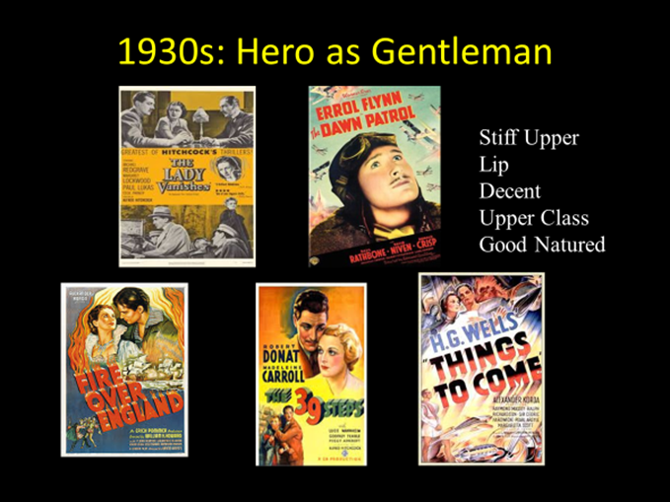

Slide 6




Pressures on the Films Division 1939
National Newspapers
Documentary Newsletter
War Office
British Film Institute
Board of Trade
Films
D
I
V
I
S
I
O
N
Film Studios
Services

Slide 7
Ministry Of Information Hierarchy 1941
(Addition of Ideas Committee)
Ministry Of Information
Planning Committee
Policy Committee
Documentary News Letter
Ideas Committee
Film Division
Crown Film Unit
Film Studios
Ealing
Rank
Gainsborough
Information and control:
Critical Comment::
Notes:
Feuer – ‘‘The musical as a genre perceives the gap between producer and consumer, the breakdown of community designated by the very distinction between "performer" and "audience" as a breach which it must heal. The musical seeks to bridge the gap through a valorization of "community" as an ideal concept. ‘
That is – the musical masks the manner of its production as elaborate industrial product in order to present events as if they were effortlessly spontaneous and representative of ordinary lives
Feuer, J. (1981). The Self-Reflective Musical and the Myth of Entertainment. In R. Altman, Genre: The Musical (pp. 159-174). London: Routledge and Keegan Paul.

Slide 8
Sources
Unpublished Primary (such as National Archives, Papers, Ministry Offices)
Published (such as Newspapers and magazines, journals)
Mass Observation Unit
Books and Articles
Memoirs
BFI: Special Collections
PhDs
Be a detective...follow the paper trail

Slide 9
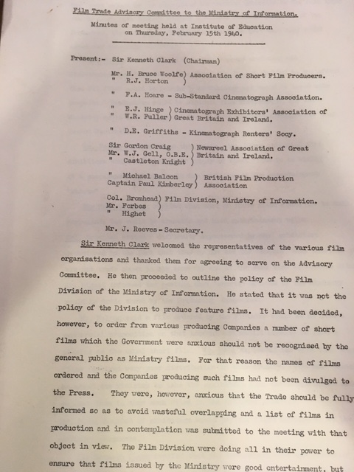

Slide 10
Exercises
National Archives: Search MOI for Films Division, Ideas Committee etc. Note no downloads
Mass Observation Online (search for Lion has Wings in advanced, use AND)
Home Intelligence Reports
War Time Social Surveys (search for cinema, results online. No login required)
Documentary News Letter on line : Year 1940. Search for Films Division
For reviews : Sight and Sound on line at Brookes (or newspapers)

Slide 11
Exercises
On line film publications: Search for Kinematograph Weekly. Choose 1944 version and search for Millions like Us
On line film publications: Search for Motion Picture Herald.
A new idea: Use Python to access archives:- https://programminghistorian.org/en/lessons/
For example IMDbpy (set of modules to access film data)
https://imdbpy.github.io/

Slide 12
Conclusions
Pressure from many political sources (not only the MOI) impacted the content of films, especially comedy.
Professor Chapman : ‘the extraordinary narrow class confines of pre war British cinema were being breached. It became more common for films to draw characters from across the British classes’.
A main desire of the MOI was to ‘keep up morale’, of which comedy was key (not only in film but on radio too).
There was a transition of the hero figure in film to a more recognisable form (as a common man or woman).
Humour in all senses has moved on, but elements of the comedy can still be enjoyed and understood today.

