Slide 1
The Civil Service welcomes outsiders: recruitment of private sector experts driving film propaganda forward during WW2
Talk by Robert Williamson, PhD candidate

Slide 2
INTRODUCTION
My main research: British Government Film Policy during World War Two.
Secondary research: The changing role of the Hero figure in British feature films during that period of war

Slide 3
The Ministry of Information

Slide 4
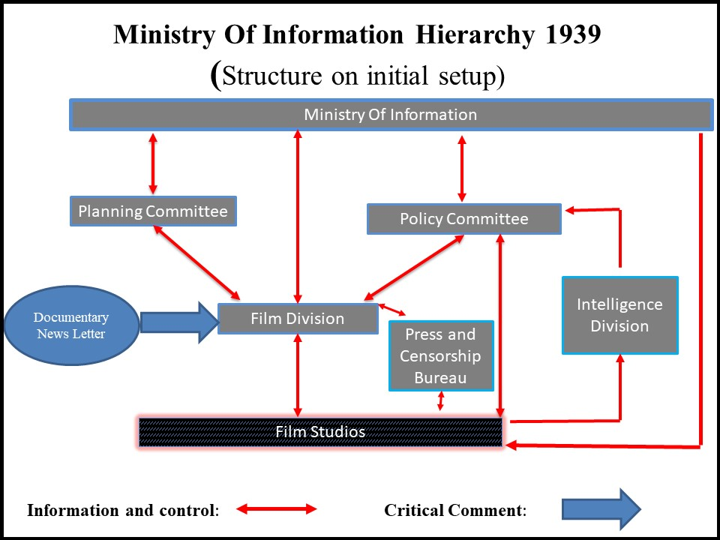
The Ministry of Information (simplified internal layout)

Slide 5
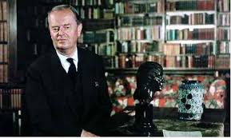
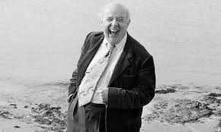
Two outsiders, Clark and Betjeman

Slide 6
References
Aldgate, A. and Richards, J (2007), Britain can take it, British Cinema in the Second World War, London: Tauris.
Chapman, J (1998). The British at War, Cinema, State and Propaganda 1939-1945, London: Tauris
Clark, K (1977). The Other Half, London: John Murray Publishers Ltd
Coultass, C (1989) Images for Battle: British Films and the Second World War: University of Delaware Press
Dickinson, M and Street S, (1985), Cinema and the State. The British Film Industry and the British Government 1927-84. London: BFI Publishing
Drazin, C (1998). The Finest Years: British Cinema in the 1940s. London: Andre Deutsch
Grandy, C (2014) Heroes and Happy Endings. Manchester University Press
Hillier, B (2007) John Betjeman: The Biography. London: John Murray

