Slide 1
The Ministry of Information and the British Film Hero during World War 2
by Robert Williamson
Click here for my Website

Slide 2
“To do film history today, one has to become an economic historian, a legal expert, a sociologist, know about censorship, read trade papers and fan magazines” Thomas Elsaesser, ‘The New Film History’ Monthly Film Bulletin, Autumn 1986

Slide 3
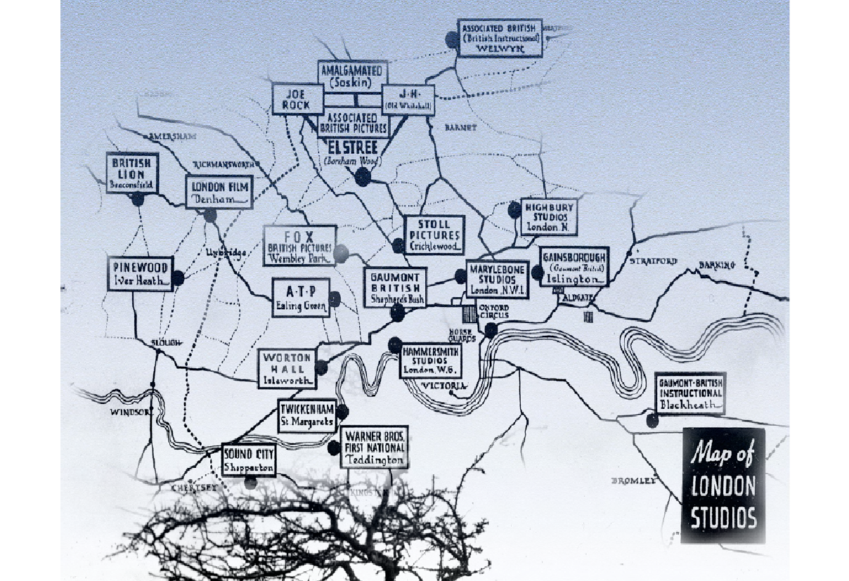
1939

Slide 5
Ministry of Information
Its principal roles was to monitor and maintain the morale of the British people. A tricky business when propaganda was often a dirty word and when the aim was to save an open society threatened on all sides by closed and authoritarian ones

Slide 6
Propaganda is the systematic effort to manipulate people's beliefs, attitudes, or actions through the use of symbols, such as words, gestures, or images, often conveyed through mass media
Professor Bruce Smith, Michigan State University
‘Propaganda, Communication and Public Opinion’

Slide 7
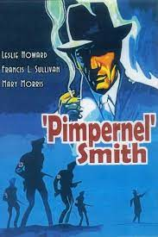
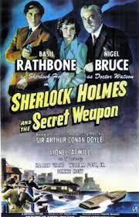
1941

Slide 8
Ministry Of Information Hierarchy 1941 (Addition of Ideas Committee)
Ministry Of Information
Planning Committee
Policy Committee
Documentary News Letter
Ideas Committee
Film Division
Crown Film Unit
Film Studios
Ealing
Rank
Gainsborough
Information and control:
Critical Comment::
Notes:
Feuer – ‘‘The musical as a genre perceives the gap between producer and consumer, the breakdown of community designated by the very distinction between "performer" and "audience" as a breach which it must heal. The musical seeks to bridge the gap through a valorization of "community" as an ideal concept. ‘
That is – the musical masks the manner of its production as elaborate industrial product in order to present events as if they were effortlessly spontaneous and representative of ordinary lives
Feuer, J. (1981). The Self-Reflective Musical and the Myth of Entertainment. In R. Altman, Genre: The Musical (pp. 159-174). London: Routledge and Keegan Paul.

Slide 9
Pressures on the Films Division 1939
National Newspapers
Documentary Newsletter
War Office
British Film Institute
Board of Trade
Films
D
I
V
I
S
I
O
N
Film Studios
Services

Slide 10
Sources
Unpublished Primary (such as National Archives, Papers, Ministry Offices)
Published (such as Newspapers and magazines, journals)
Mass Observation Unit
Books and Articles
Memoirs
BFI: Special Collections
PhDs
Be a detective...follow the paper trail

Slide 11
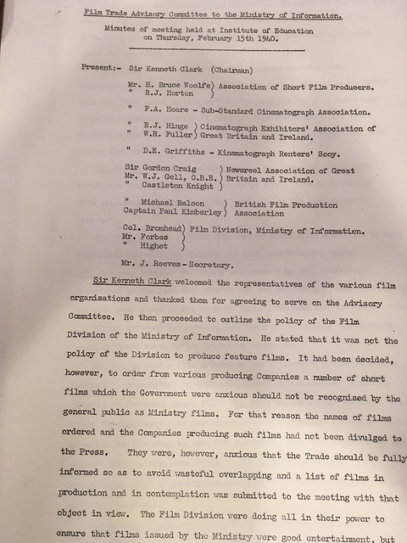

Slide 12
Exercises
National Archives: Search MOI for Films Division, Ideas Committee etc. Note no downloads
Mass Observation Online (search for Lion has Wings in advanced, use AND)
Home Intelligence Reports
War Time Social Surveys (search for cinema, results online. No login required)
Documentary News Letter on line : Year 1940. Search for Films Division
For reviews : Sight and Sound on line at Brookes (or newspapers)

Slide 13
Exercises
On line film publications: Search for Kinematograph Weekly. Choose 1944 version and search for Millions like Us
On line film publications: Search for Motion Picture Herald.
A new idea: Use Python to access archives:- https://programminghistorian.org/en/lessons/
For example IMDbpy (set of modules to access film data)
https://imdbpy.github.io/

Slide 14
Conclusions
Pressure from many political sources (not only the MOI) impacted the content of films, especially comedy.
Professor Chapman : ‘the extraordinary narrow class confines of pre war British cinema were being breached. It became more common for films to draw characters from across the British classes’.
A main desire of the MOI was to ‘keep up morale’, of which comedy was key (not only in film but on radio too).
There was a transition of the hero figure in film to a more recognisable form (as a common man or woman).
Humour in all senses has moved on, but elements of the comedy can still be enjoyed and understood today.

Slide 15
Archive Research: Advice
Scoping the Archives: Determine which ones to look at (first pass)
Select a series of themes, keywords, and names that summarize your research (These keywords will eventually help you narrow down particular collections, but they also help you identify which archives will likely contain documents of relevance to you).
A research project on the MOI, for instance, will likely begin with secondary research. A simple trip to the library will provide the names of important politicians, social activists, government programs, and legislative acts related to the topic.
Some archives are not indexed so careful notes required to identify the document(s).
Some archives can be searched online (National Archives at Kew for example).
Some archives are online (e.g. some of the Newspaper library), but most are paper based (again most of the Newspaper Library).
Some archives have good study aids for an area of research (eg BFI Library).
Record where/when accessed. More information is better than less!
When possible, save digital copies/photos. Could use new folder for each new archive.
Arrange your records according to a theme (e.g.: MOI/cabinet office communications).
If archive is a distance away, organise your time there very carefully.
Be realistic, as some archives only contain fragments.
Work with the Archivist (they are there to help): Have a succinct overview of the research project with clearly stated objectives for that archives
Be prepared for lost/destroyed or restricted material.
Expect the un-expected!
Always review which archive to access every now and then.
Lastly, organise your notes!

